Slide 1
Generating Maps with Location Hotspots and Leveraging Foursquare for Tourism
Justin Zheng 21.8.2019
Applied Data Science Capstone

Slide 2
Introduction and Business Problem
The purpose of this data project is to use the Foursquare location and venue data in order to generate maps that would be able to show hotspots in Rittenhouse Square Philadelphia, PA.
Such maps are intended to be printed and handed to tourists for guidance
To generate relevant maps, I will need to determine the most important categories of venues, for example a shopping mall or a convenience store.
Distance and radius of location search for the Foursquare data base for venues will need to be individually determined through trial and error in order to generate an appropriately extensive list of venues in each category

Slide 3
Relevance
The target audience for this particular data science project is tourists and venues associated with tourism like hotels
Such venues often display and allow visitors to take maps with them to help them navigate in the neighborhood
These maps are meant to offer a simple and individualized navigational guide

Slide 4
Data
A majority of location data was scraped directly from Foursquare
Data included postal codes, names, longitude and latitude values and exact addresses of different venues
Example of a cleaned data frame with Foursquare data:
Longitude and latitude values that were acquired through Foursquare were used to form maps
Postal codes acquired through Foursquare were further used to identify specific neighborhoods and to selectively clean data
Other data bases were also used such as Apple Maps and Google to manually fill missing values

Slide 5
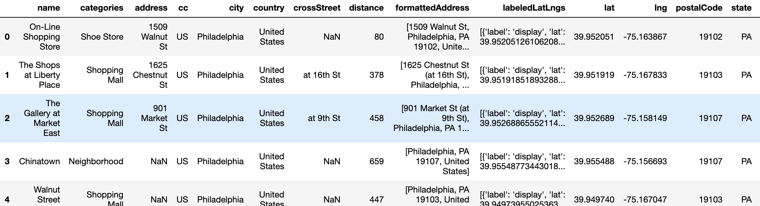
Data Cleaning
I ran a function that extracts venue categories from the original data scraped from Foursquare then filtered each row. The end result was as follows:
2. Irrelevant Columns were removed and columns renamed with a loop function
3. Filled out missing data

Slide 6
Methodology
1. I imported requests for requests, pandas and numpy for data analysis. I also imported Nominatim for latitude and longitude transformation, Image and HTML from IPython for images, json_normalize for changing a json file into a pandas data frame library and folium for plotting.
2. Establishing geolocator for Philadelphia
3. Parameters such as category and radius were added to a url with my credentials to retrieve data from Foursquare.
4. Sent the GET request and transformed it into a pandas dataframe

Slide 7
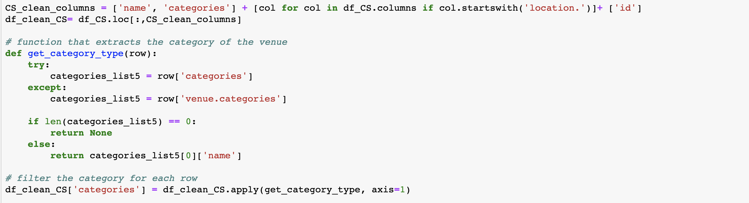
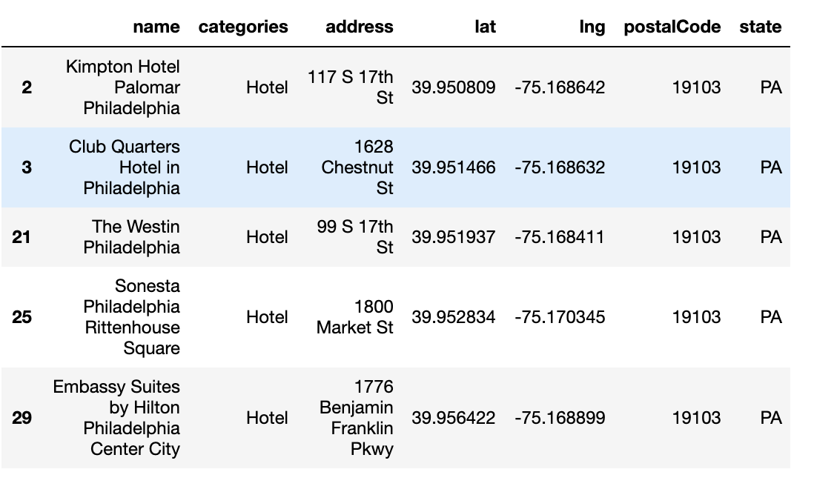
5. Data cleaning
6. Re-running searches with different radius amounts ranging from 500, 1000, 1500 and 2000 to find optimal distance
7. This was an iterative process and the final result looked like this

Slide 8
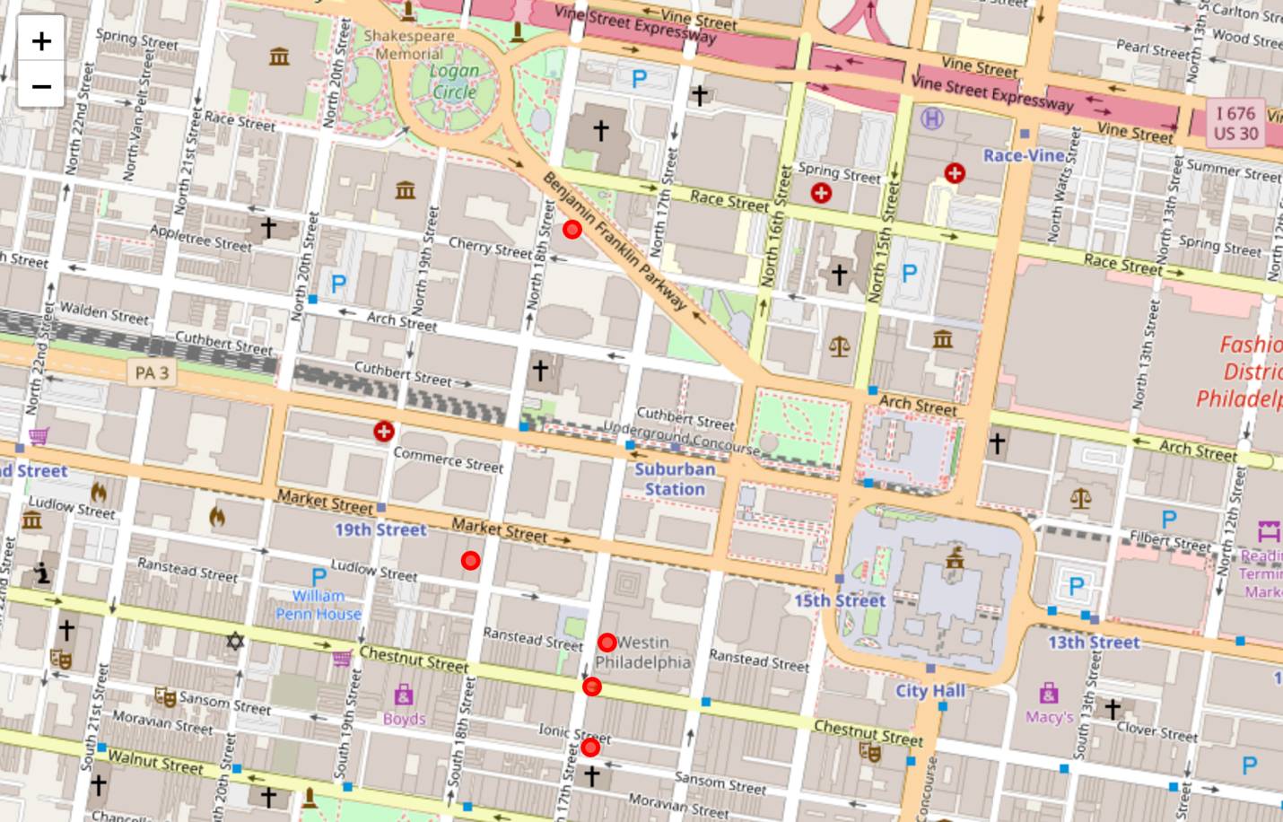
Results and Maps

Slide 9
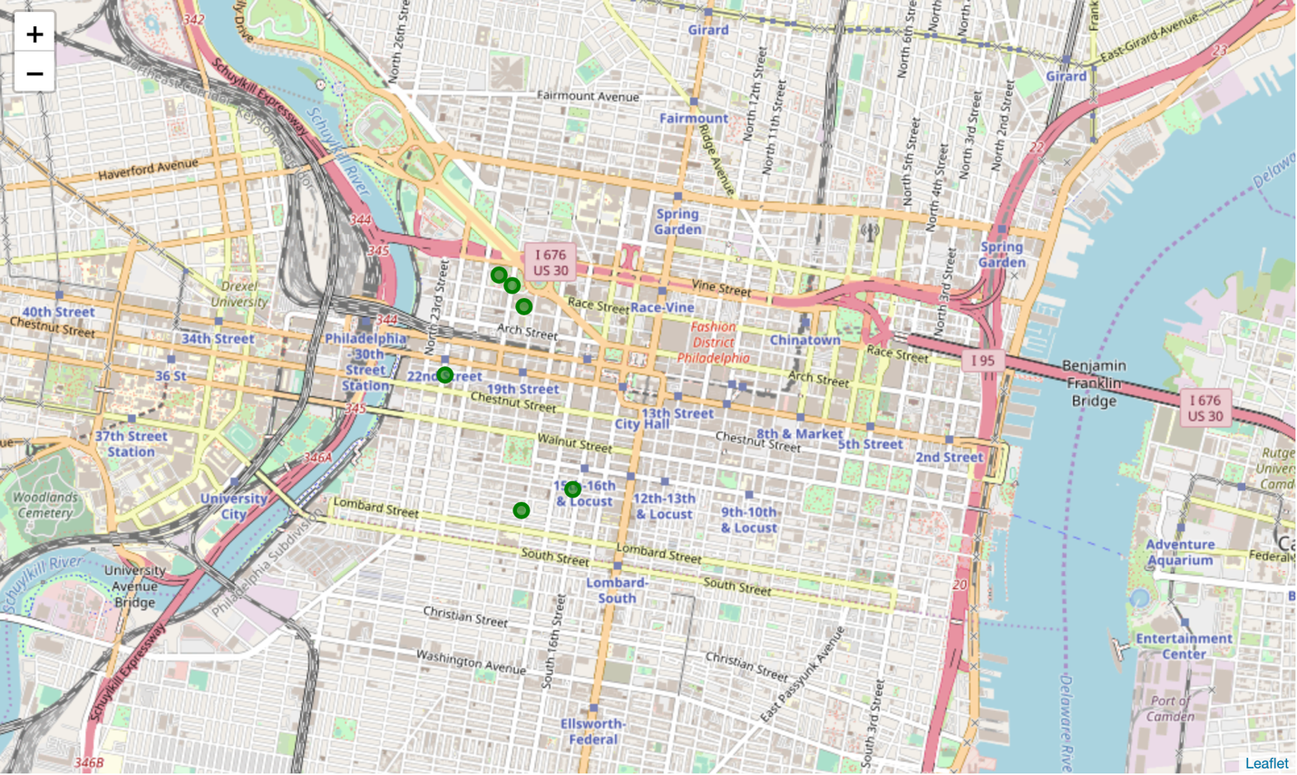

Slide 10
Venues were marked by a circle with each category designated a different color
Final result was five clustered maps

Slide 11
Discussion and Conclusion
More databases should be used to increase accuracy
Other non-location based can also be leveraged such as Yelp or Facebook
Having individual maps increases clarity as if all venues were to be clustered together it would be messy
Proximity of areas could be measured with different streets, landmarks or buildings instead of postal codes to improve accuracy
Foursquare data contained many mistakes hence trial and error was needed. Due to such errors, manual methods of data analysis was needed, hence machine learning is not the most appropriate method to approach this kind of problem

